Slide 1

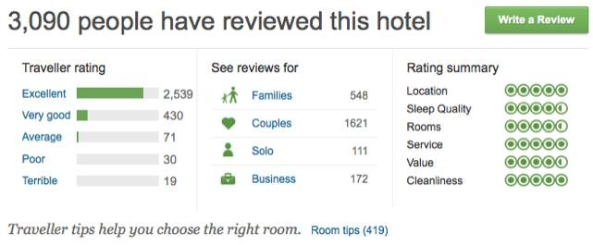

Slide 2





TRIPADVISOR SENTIMENT ANALYSIS
PROJECT
By Karen, Islamia, Marieme, Yasser

Slide 3



agenda
1
5
Why a sentiment analysis
Modelization training
2
6
Data exploration
3
Test
Structuring data
7
4
Conclusion
Data Preparation

Slide 4

Understanding Customer Satisfaction
Why Analyze TripAdvisor Sentiment?
Identifying Trends and Strengths/Weaknesses
Informed Decision Making
Online Reputation Management
Competitive Comparison

Slide 5
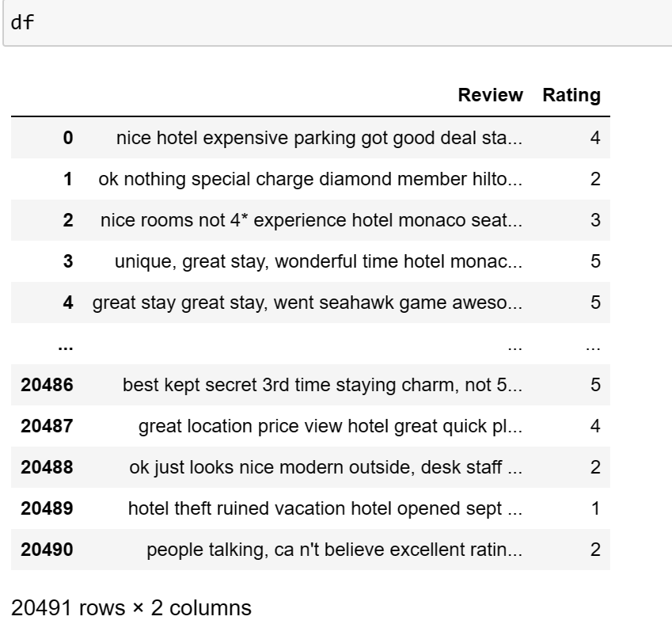
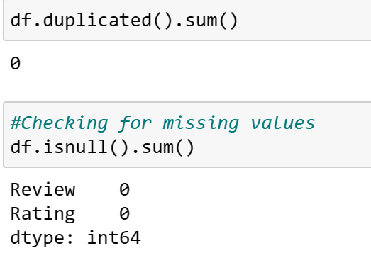
Data Exploration

Slide 6
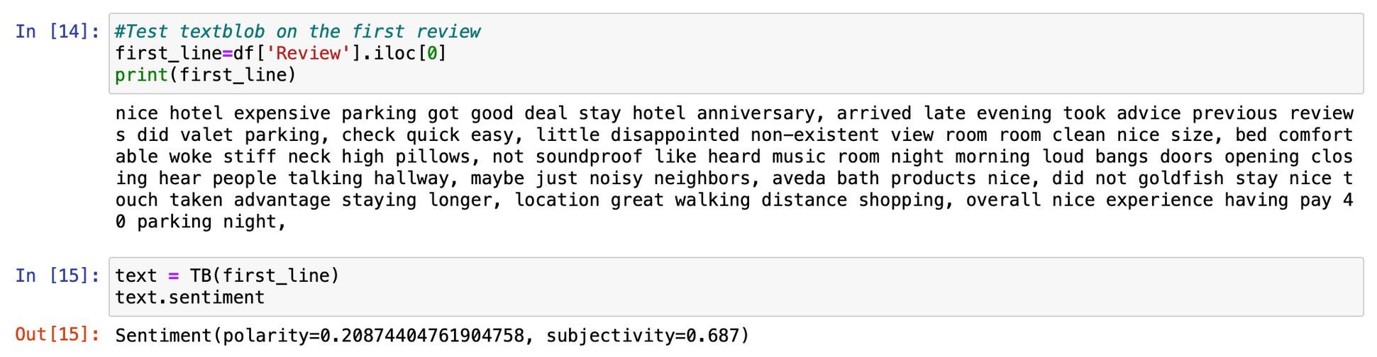
Structure Data
TextBlob is a Python library that analyzes text sentiment (positive or negative) and determines subjectivity (opinion vs. fact)
Polarity = 0.2
Subjectivy = 0.687

Slide 7
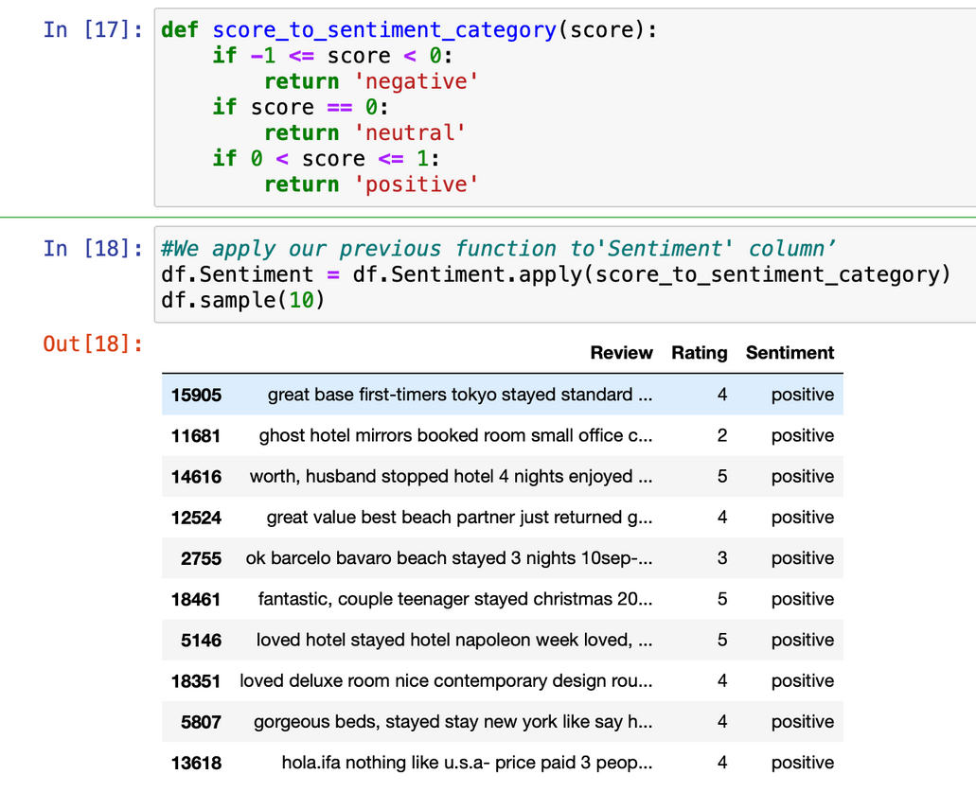
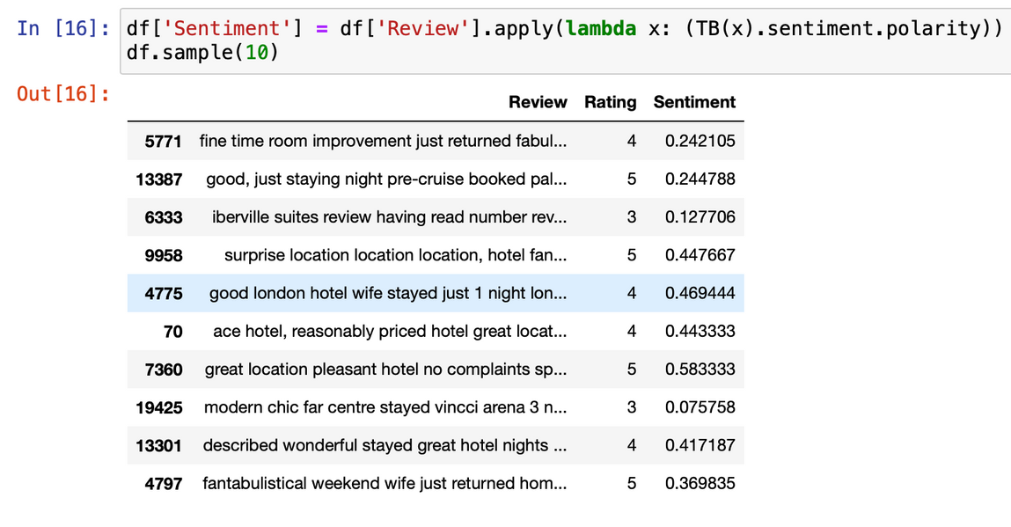
Structure Data

Slide 8
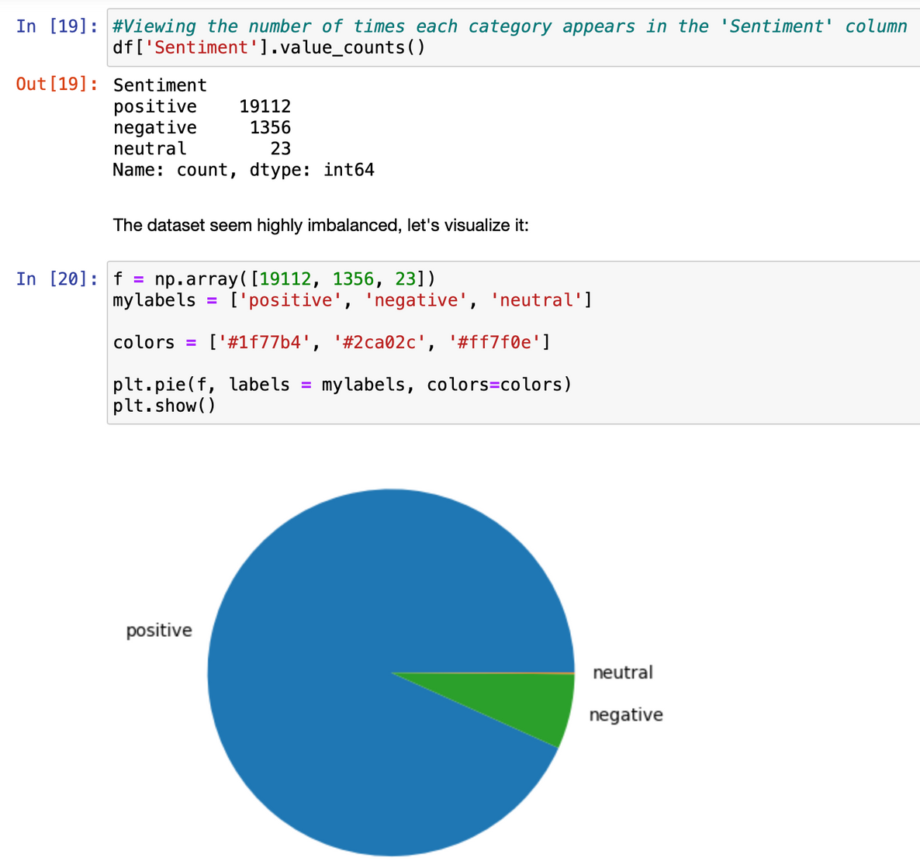
Structure Data

Slide 9
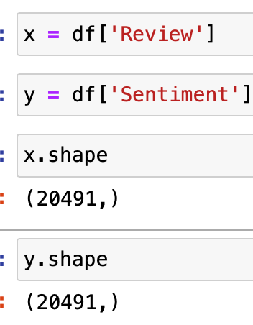
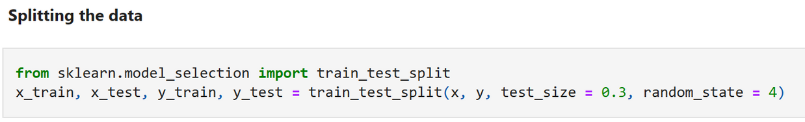
Data preparation
Feature selection

Slide 10
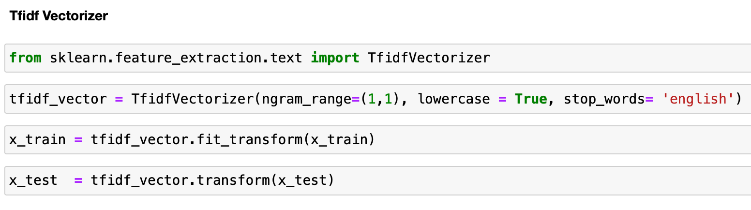
Data preparation
Tfidf Vectorizer : convert text data into numerical feature vector

Slide 11
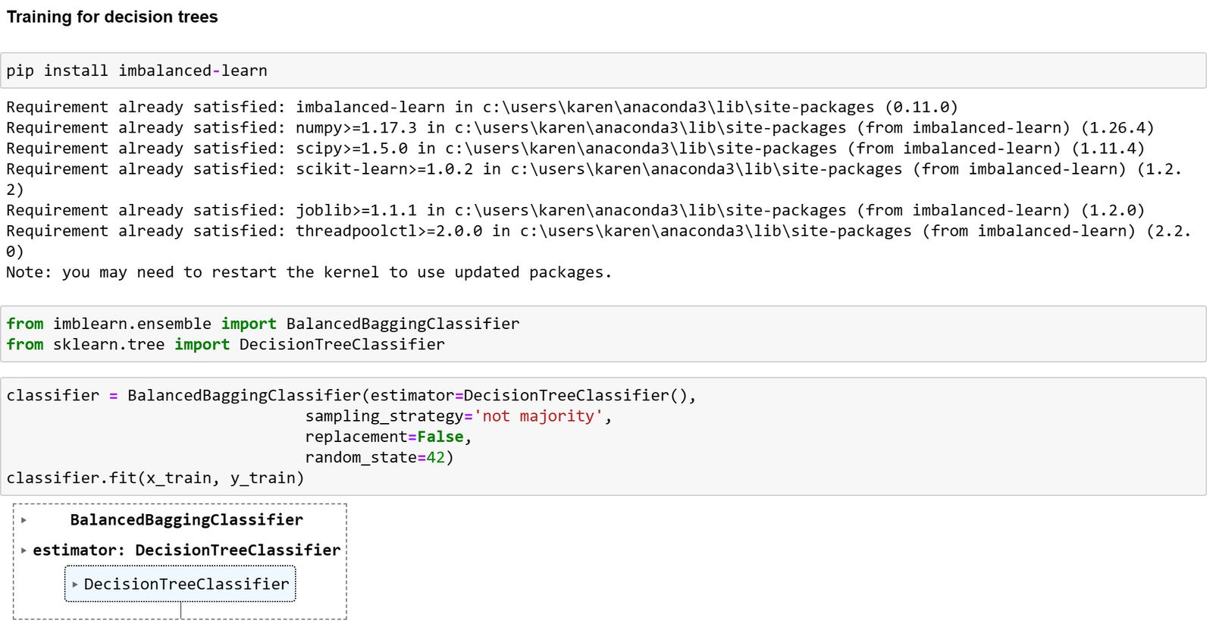
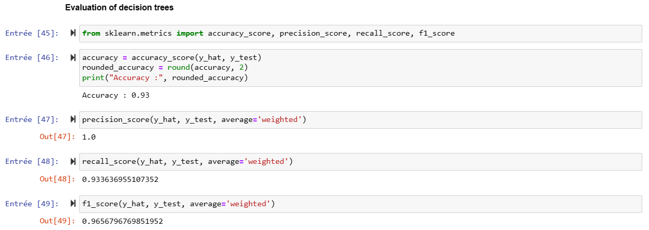
Modelization training
Balancing the data, and training for decision tree
Evaluation of decision trees

Slide 12
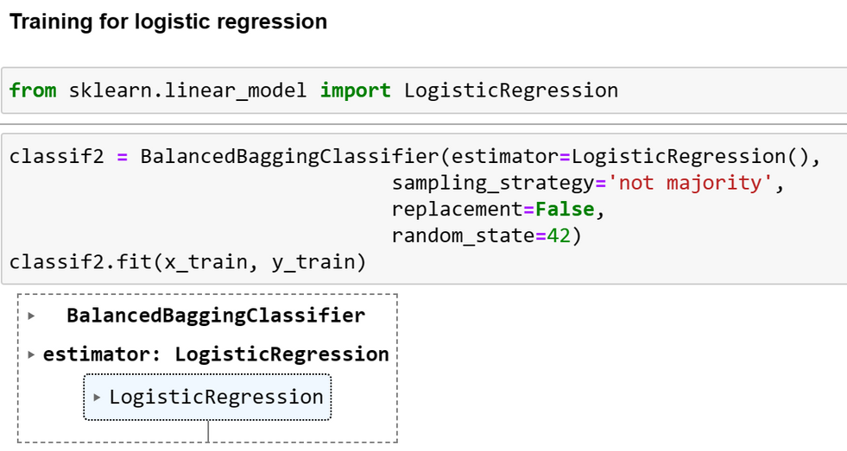
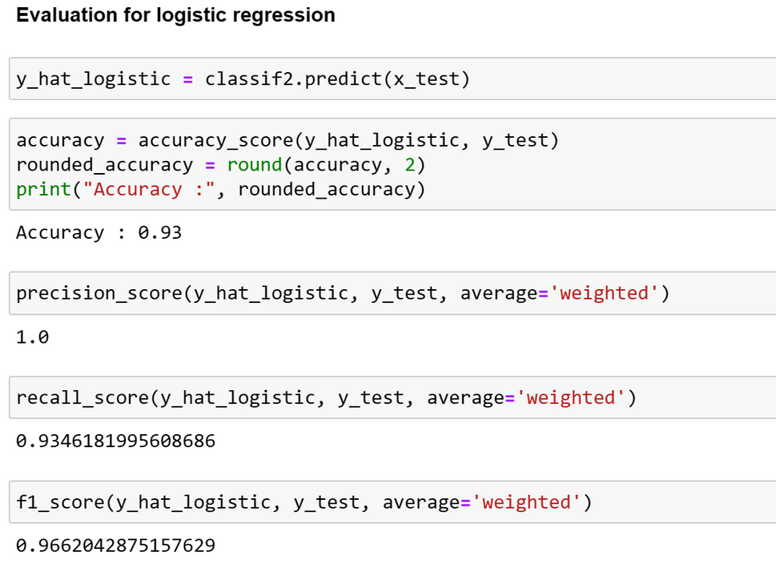
Evaluation of logistic regression
Logistic regression training

Slide 13
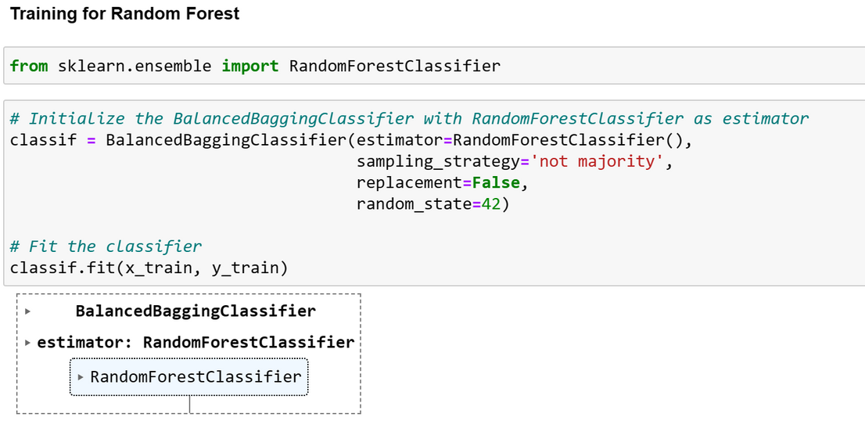
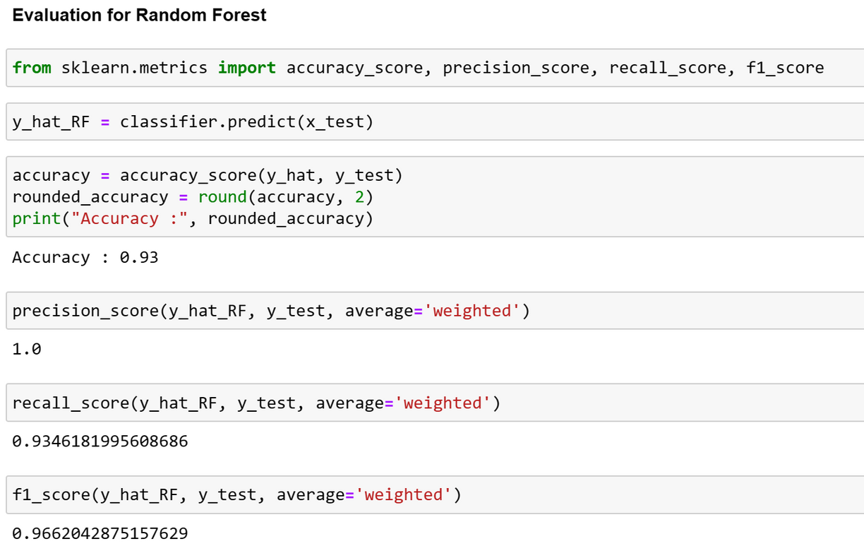
Training for Random Forest
Evaluation for Random Forest

Slide 14
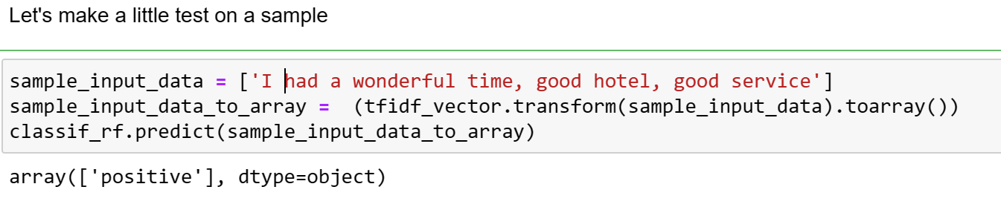
test on a sample

Slide 15
Conclusion

